Slide 1

Learning Objective
I will be able to expand, factorise and solve quadratic equations
Enter quietly, please be ready with the following on your desk:
Whiteboard
Whiteboard marker
Exercise Book
Pencil, pen, ruler and red pen
Diary
Calculator (Scientific and ClassPad)
Device – charged or borrowed from Library before maths

Slide 2
Learning Objective
CFU
What will we learn today?
I will be able to expand, factorise and solve quadratic equations
CFU
How will you know that you are successful?
Success Criteria
At the end of the lesson, I will be able to:
Expand using distributive law and FOIL
Factorise quadratic equations
Solve quadratic equations

Slide 3
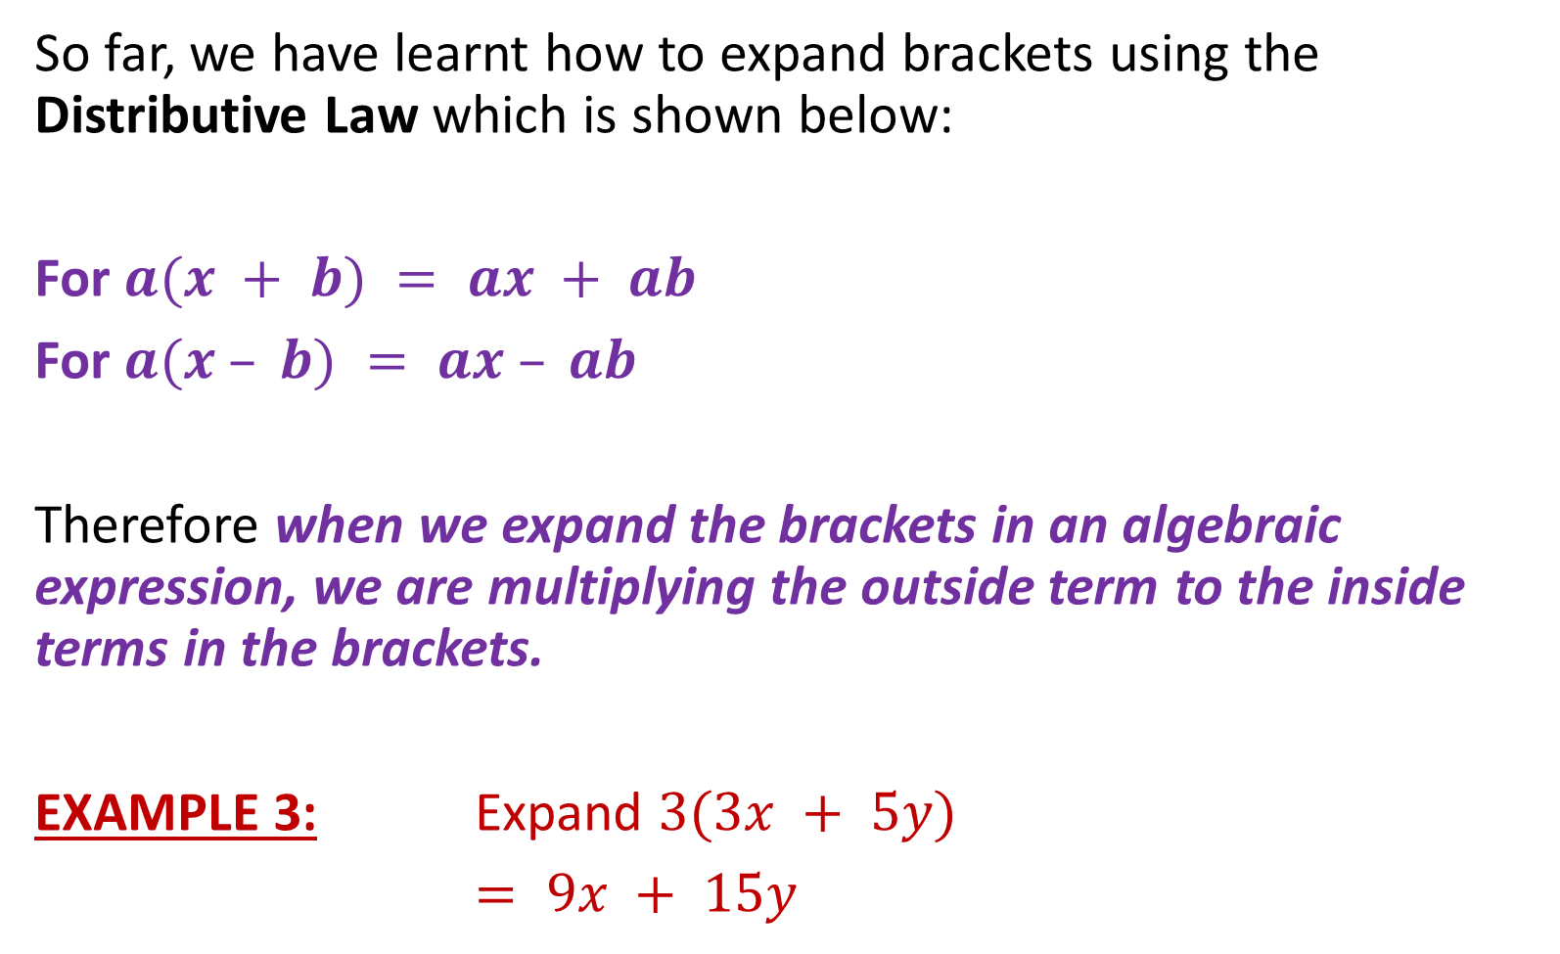
Concept Development
So far, we have learnt how to expand brackets using the Distributive Law which is shown below:
For $a(x + b) = ax + ab$
For $a(x – b) = ax – ab$
Therefore when we expand the brackets in an algebraic expression, we are multiplying the outside term to the inside terms in the brackets.
EXAMPLE 3: Expand $3(3x + 5y)$
$= 9x + 15y$

Slide 4
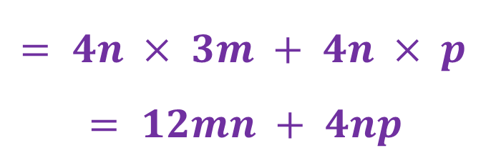


Skill Development
Expand the following:
$4n(3m + p)$
$3(x + 5) + 2(x – 4)$
$= 4n × 3m + 4n × p$
$$= 12mn + 4np$$
$$= 3x + 15 + 2x – 8$$
$$= 5x + 7$$

Slide 5

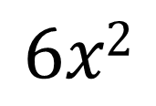
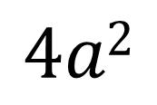


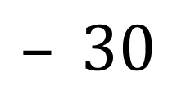
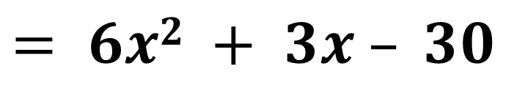

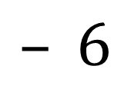

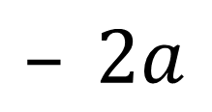
Skill Development
Using FOIL, expand the following binomial products
F = First
O = Outer
I = Inner
L = Last
$$(2x + 5)(3x – 6) =$$
$$(4a – 2)(a + 3) =$$
$$6x2$$
$$– 12x$$
$$+ 15x$$
$$– 30$$
$= 6x2 + 3x – 30$
$$4a2$$
$$+ 12a$$
$$– 2a$$
$$– 6$$
$= 4a2 + 10a – 6$

Slide 6
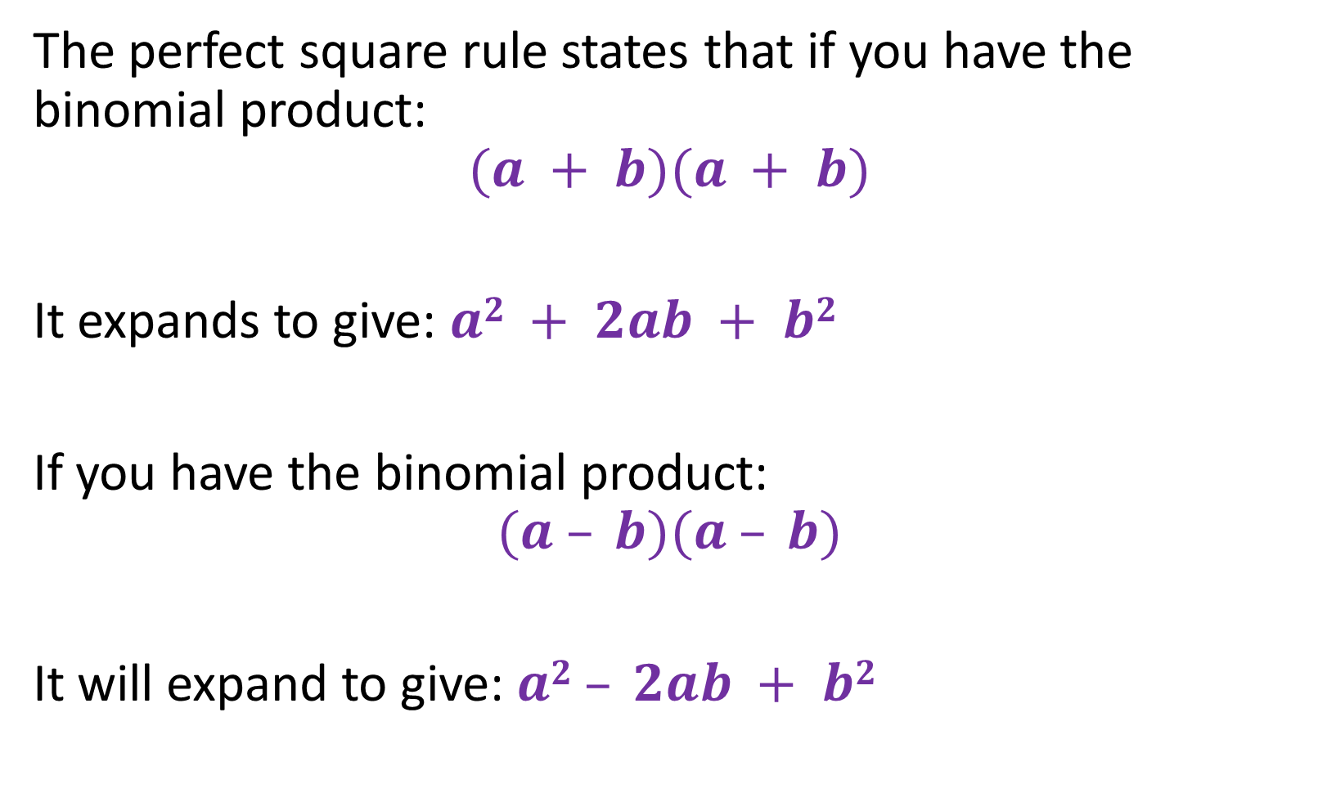
Concept Development
The perfect square rule states that if you have the binomial product:
$$(a + b)(a + b)$$
It expands to give: $a2 + 2ab + b2$
If you have the binomial product:
$$(a – b)(a – b)$$
It will expand to give: $a2 – 2ab + b2$

Slide 7


Concept Development
Perfect square rules:
$${\left(a+b\right)}^{2}=a^{2}+2ab+b^{2}$$
$${\left(a−b\right)}^{2}=a^{2}−2ab+b^{2}$$

Slide 8
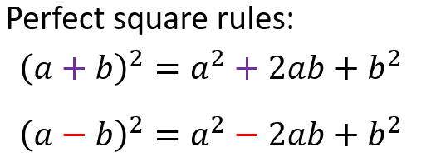
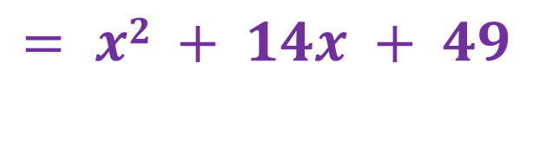

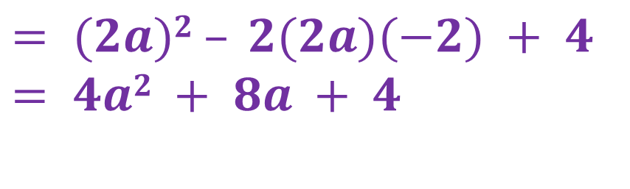
Skill Development
Use the perfect squares to expand the following:
$$(x + 7)(x + 7)$$
$$(2a – 2)(2a – 2)$$
$$= x2 + 14x + 49$$
$$= (2a)2 – 2(2a)(−2) + 4$$
$$= 4a2 + 8a + 4$$

Slide 9
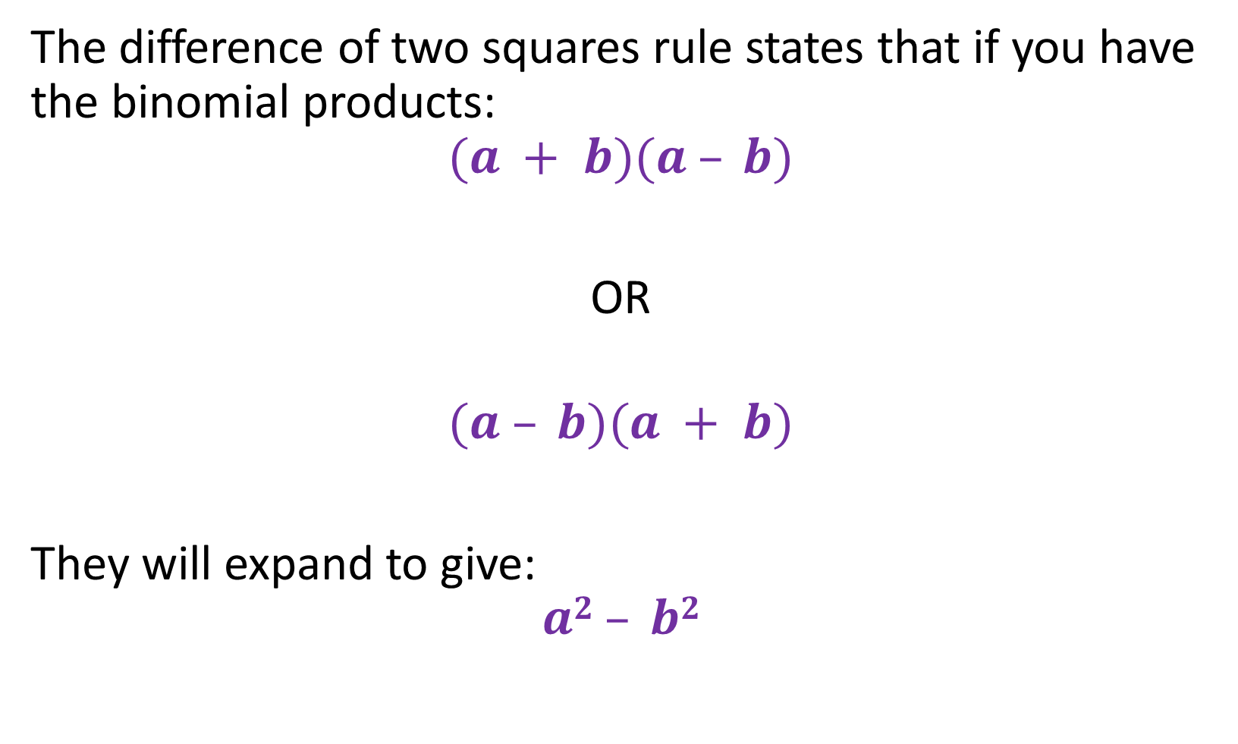
Concept Development
The difference of two squares rule states that if you have the binomial products:
$$(a + b)(a – b)$$
OR
$$(a – b)(a + b)$$
They will expand to give:
$$a2 – b2$$

Slide 10




Skill Development
Use the difference of squares to expand the following:
$$(x – 6)(x + 6)$$
$$(2a – 3)(2a + 3)$$
$$= x2 – 36$$
$$= (2a)2 – 9$$
$$= 4a2 – 9$$
The difference of squares states
if we have
$$(a – b)(a + b)$$
OR
$$(a + b)(a – b)$$
They expand to give $a2 – b2$

Slide 11

Summary
Perfect square rules:
$${\left(a+b\right)}^{2}=a^{2}+2ab+b^{2}$$
$${\left(a−b\right)}^{2}=a^{2}−2ab+b^{2}$$
Difference of square rules:
$$\left(a+b\right)\left(a−b\right)=a^{2}−b^{2}$$

Slide 12

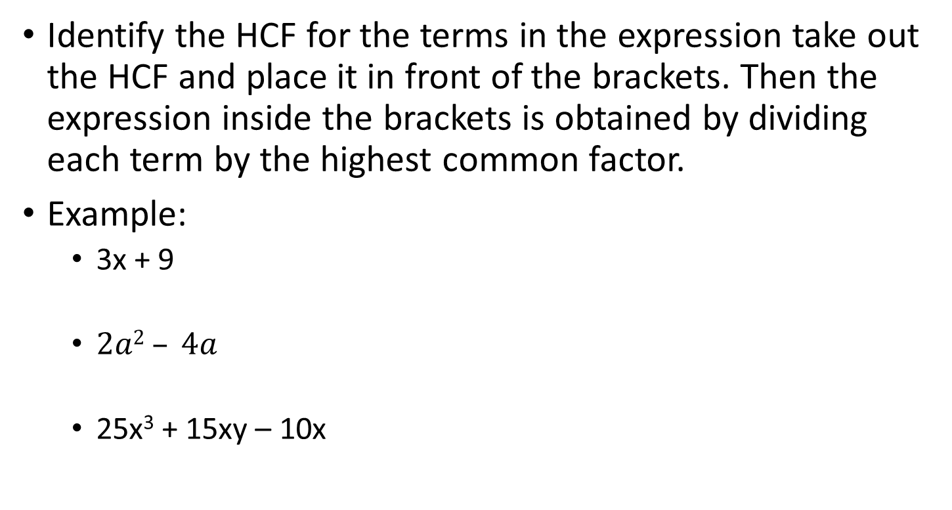


Factorisation by Highest Common Factor (HCF)
Concept Development
Identify the HCF for the terms in the expression take out the HCF and place it in front of the brackets. Then the expression inside the brackets is obtained by dividing each term by the highest common factor.
Example:
3x + 9
$2a2 – 4a$
25x³ + 15xy – 10x
$$=3(x+3)$$
$$=2a(a−2)$$
$$=5x(5x^{2}+3y−2)$$

Slide 13
Factorisation by grouping
Skill Development
If you have four terms with no HCF, then try factoring by grouping.
Step 1: Group the first two terms together and then the last two terms together.
Step 2: Factor out a HCF from each separate binomial.
Step 3: Factor out the common binomial.

Slide 14








Guided Practice
$3ax – a + 12x – 4$
$gh – 6 + 2g – 3h$
$$=a(3x−1)$$
$$+ 4(3x−1)$$
$$=(3x−1)(a+4)$$
$$=gh+2g−6−3h$$
$$=g(h+2)$$
$$−3(2+h)$$
$$=(h+2)(g−3)$$

Slide 15
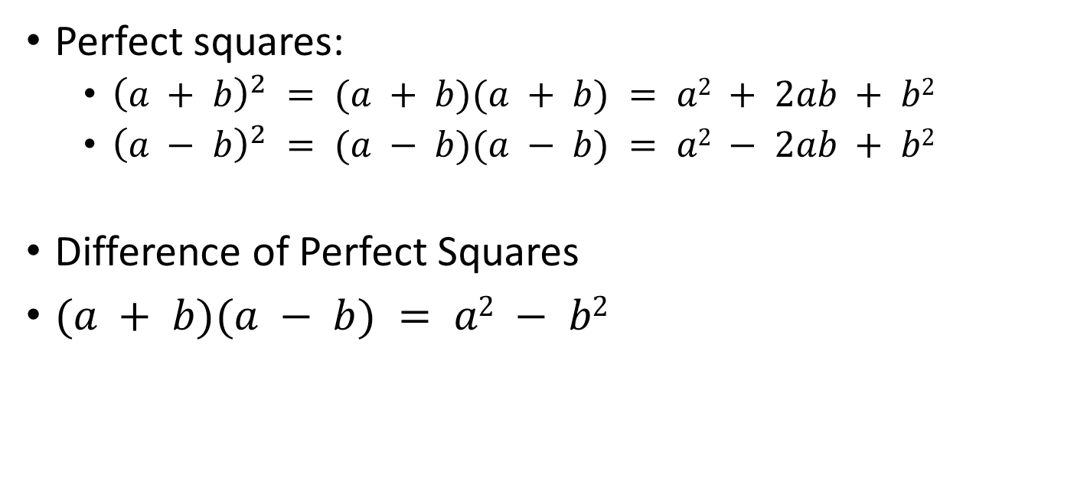
Factorising perfect squares and differences of perfect square
Skill Development
Perfect squares:
${\left(a + b\right)}^{2} = (a + b)(a + b) = a2 + 2ab + b2$
${\left(a − b\right)}^{2} = (a − b)(a − b) = a2 − 2ab + b2$
Difference of Perfect Squares
$(a + b)(a − b) = a2 − b2$

Slide 16


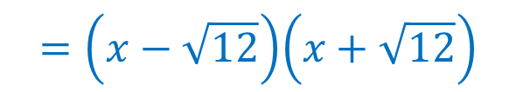






$x2 + 6x +9$
$h2 −14h+49$
$c2 −25$
$x2 −12$
$(h+2)2 −49$
$(c−3)2 − (c+4)2$
$$=\left(x−\sqrt{12}\right)\left(x+\sqrt{12}\right)$$
$$={\left(x+3\right)}^{2}$$
$$={\left(h−7\right)}^{2}$$
$$=(\left(h+2\right)−7)((h+2)+7)$$
$$=(h−5)(h+9)$$
$$=(c−5)(c+5)$$
$$=\left(\left(c−3\right)−\left(c+4\right)\right)((c−3)+\left(c+4\right))$$
$$=\left(c−3−c−4\right)(c−3+c+4)$$
$$=−7(2c+1)$$

Slide 17
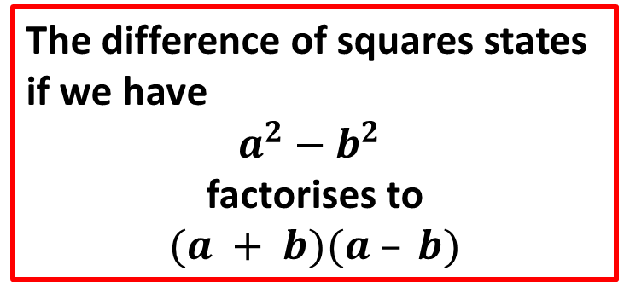
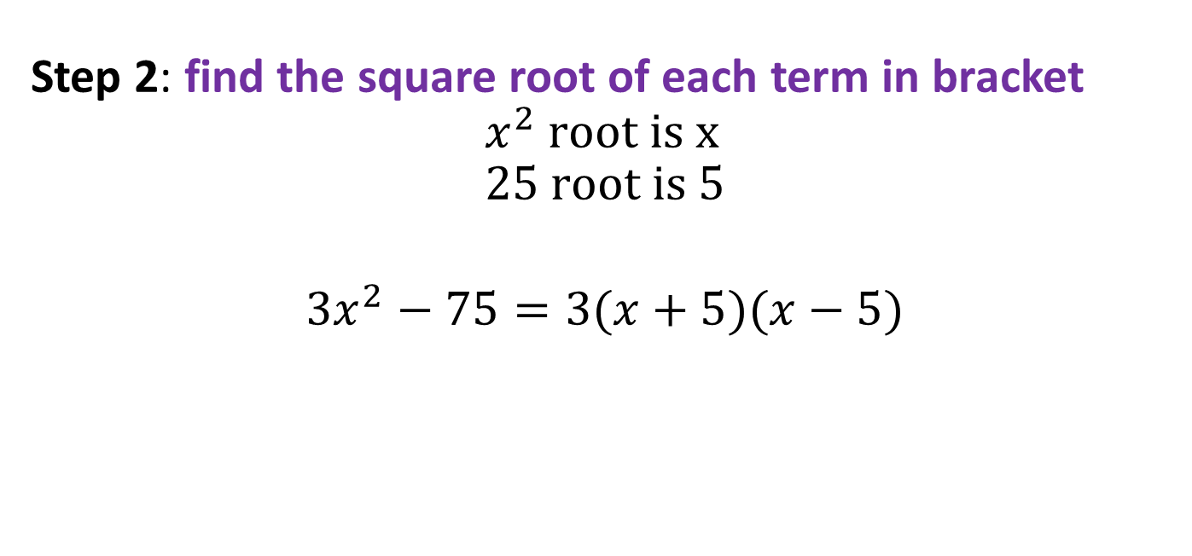

Guided Practice
Factorise ${3x}^{2 }−75$
Step 1: Factorise common factor out
$$3x^{2}−75=3(x^{2}−25)$$
Step 2: find the square root of each term in bracket
$$x^{2} root is x \\ 25 \text{root} \text{is} 5$$
$${3x}^{2}−75=3(x+5)(x−5)$$
The difference of squares states
if we have
$a^{2}−b^{2}$
factorises to
$$(a + b)(a – b)$$

Slide 18



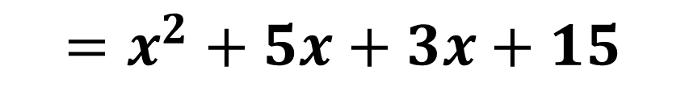

Binomial products
Activating Prior Knowledge
$$(x + 3)(x +5)$$
Use the Distributive law
$$(x + 3)(x +5) =$$
$$x\left(x+5\right)+3(x+5)$$
$$=x^{2}+5x+3x+15$$
$$=x^{2}+8x+15$$

Slide 19
Reverse the process
Concept Development
x² + 8x + 15 = x² + 5x + 3x + 15
= x(x+5) + 3(x+5)
= (x + 3)(x +5)
(x + 3)(x +5) = x² + 8x + 15

Slide 20
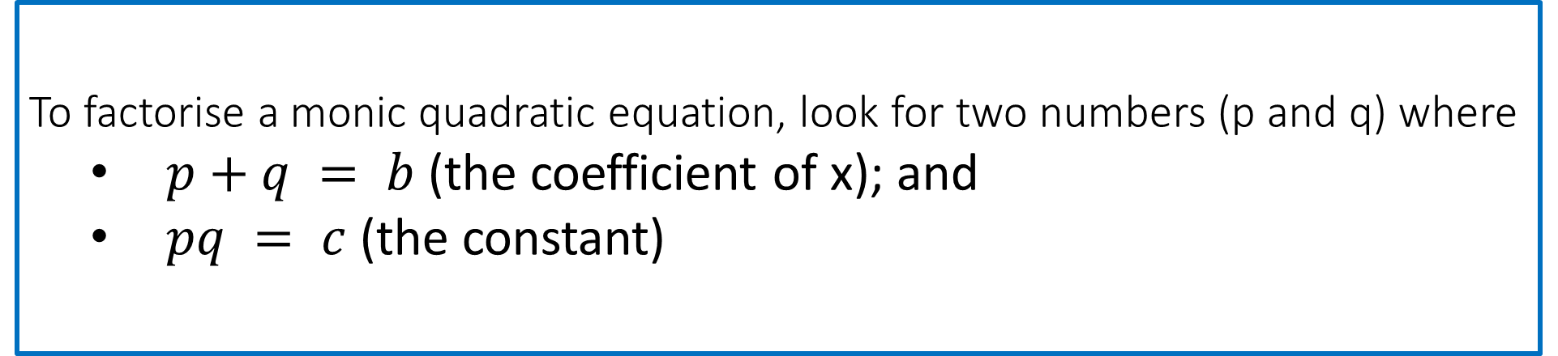
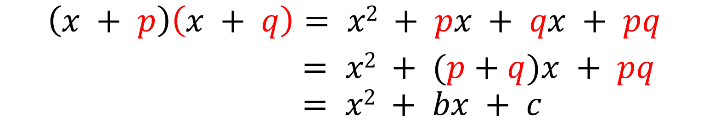
In general
Concept Development
$$\left(x + p\right)\left(x + q\right)= x2 + px + qx + pq$$
$= x2 + (p+q)x + pq$
$$= x2 + bx + c$$
To factorise a monic quadratic equation, look for two numbers (p and q) where
$p+q = b$(the coefficient of x); and
$pq = c$(the constant)

Slide 21


Factorise the following:
Guided Practice
$$x2 + 6x + 8$$
Step 1: Determine values of $p,q$ given that $pq=8, p+q=6$
$$p=2, q=4$$
Step 2: r$ewrite 6x$ into $2x+4x$
$${x^{2}+6x+8= x}^{2}+2x+4x+8$$
Step 3: Factorise
$$x^{2}+2x+4x+8=x\left(x+2\right)+4(x+2)$$
$$=(x+2)(x+4)$$

Slide 22


Factorise the following:
Guided Practice
$$h2 + h − 30$$
Step 1: Determine values of $p,q$ given that $pq=−30, p+q=1$
$$p=6, q=−5$$
Step 2: r$ewrite h$ into $6h−5h$
$$h2 + h − 30=h^{2}+6h−5h−30$$
Step 3: Factorise
$$h^{2}+6h−5h−30=h\left(h+6\right)−5(h+6)$$
$$=(h+6)(h−5)$$

Slide 23


Factorise the following:
Guided Practice
$$x^{2}+5x+6$$
Step 1: Determine values of $p,q$ given that $pq=6, p+q=5$
$$p=2, q=3$$
Step 2: r$ewrite h$ into $2x+3x$
$$x^{2}+5x+6=x^{2}+2x+3x+6$$
Step 3: Factorise
$$x^{2}+2x+3x+6=x\left(x+2\right)+3(x+2)$$
$$=(x+2)(x+3)$$

Slide 24


Factorise the following:
Guided Practice
$$x^{2}−x−12$$
Step 1: Determine values of $p,q$ given that $pq=−12, p+q=−1$
$$p=3, q=−4$$
Step 2: r$ewrite h$ into $3x−4x$
$$x^{2}−x−12=x^{2}+3x−4x−12$$
Step 3: Factorise
$$x^{2}+3x−4x−12=x\left(x+3\right)−4(x+3)$$
$$=(x+3)(x−4)$$

Slide 25



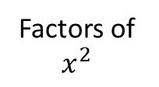








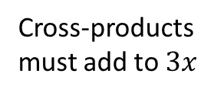



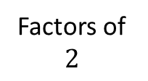


Skill Development
Factorise the following quadratic expression using the cross method:
$${ x}^{2} + 3x + 2$$
Factors of $x^{2}$
Factors of $2$
Cross-products must add to $3x$
$$($$
$$x$$
$$+$$
$$2$$
$$)$$
$$2x$$
$$+$$
$$($$
$$x$$
$$+$$
$$1$$
$$)$$
$$x$$
$$x^{2}+3x+2= \left(x+2\right)(x+1)$$
$$3x$$

Slide 26


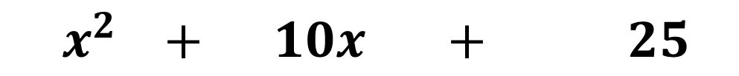
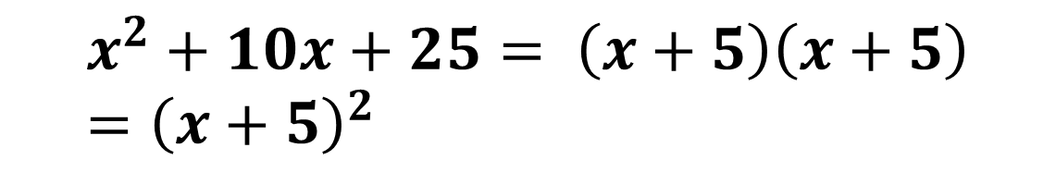


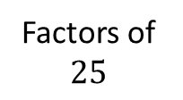

Skill Development
Factorise the following quadratic expression using the cross method:
$${ x}^{2} + 10x + 25$$
Factors of $x^{2}$
Factors of $25$
Cross-products must add to $3x$
$$($$
$$x$$
$$+$$
$$5$$
$$)$$
$$5x$$
$$+$$
$$($$
$$x$$
$$+$$
$$5$$
$$)$$
$$5x$$
$$x^{2}+10x+25= \left(x+5\right)\left(x+5\right)={\left(x+5\right)}^{2}$$
$$10x$$

Slide 27




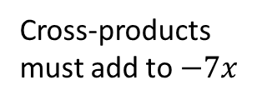

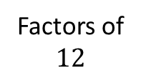

Skill Development
Factorise the following quadratic expression using the cross method:
$${ x}^{2}−7x+12$$
Factors of $x^{2}$
Factors of $12$
Cross-products must add to $−7x$
$$($$
$$x$$
$$+$$
$$−4$$
$$)$$
$$−4x$$
$$+$$
$$($$
$$x$$
$$+$$
$$−3$$
$$)$$
$$−3x$$
$$x^{2}−7x+12= \left(x−4\right)\left(x−3\right)$$
$$−7x$$

Slide 28



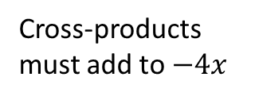

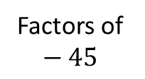
Skill Development
Factorise the following quadratic expression using the cross method:
$${ x}^{2}−4x−45$$
Factors of $x^{2}$
Factors of $−45$
Cross-products must add to $−4x$
$$($$
$$x$$
$$+$$
$$−9$$
$$)$$
$$−9x$$
$$+$$
$$($$
$$x$$
$$+$$
$$5$$
$$)$$
$$5x$$
$$x^{2}−4x−45= \left(x−9\right)\left(x+5\right)$$
$$−4x$$

Slide 29





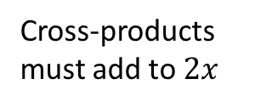

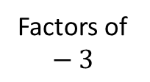

Skill Development
Factorise the following quadratic expression using the cross method:
$${ 4x}^{2}+8x−12$$
Factors of $x^{2}$
Factors of $−3$
Cross-products must add to $2x$
Factorise out common factor first
$$+$$
$$($$
$$x$$
$$3$$
$$)$$
$$3x$$
$${ 4(x}^{2}+2x−3)$$
$$+$$
$$($$
$$x$$
$$+$$
$$−1$$
$$)$$
$$−x$$
$${4x}^{2}+8x−12=4\left(x+3\right)\left(x−1\right)$$
$$2x$$

Slide 30









Skill Development
Factorise the following quadratic expression using the cross method:
$${ 8x}^{2}+2x−15$$
Factors of ${8x}^{2}$
Factors of $−15$
Cross-products must add to $2x$
$$($$
$$4x$$
$$+$$
$$−5$$
$$)$$
$$−10x$$
$$+$$
$$($$
$$2x$$
$$+$$
$$3$$
$$)$$
$$12x$$
$${8x}^{2}+2x−15= \left(4x−5\right)\left(2x+3\right)$$
$$2x$$

Slide 31

Null factor law
Skill Development
If the product of two variables $m$ and $n$,
$$mn=0$$
then $m=0$ or $n=0$ or $m=n=0$.
To solve a quadratic equation, move all terms to the left-hand side of the equation, factorise and then use the null factor law to solve the equation.
If you have a variable (pronumeral) which is a common factor, DO NOT divide by it, factorise instead.
Note the this can only apply to quadratic equations with two roots and one root.

Slide 32

Concept Development
To solve quadratic equations:
Step 1: Equate the equation to 0 (e.g. $ax^{2}+bx+c=0$)
Step 2: Factorise the quadratic
Step 3: Use the Null Factor Law where if $ab=0$, then $a=0$ or $b=0$ (or both)

Slide 33
Skill Development
Solve the following equation using the null factor law
$$x\left(x+3\right)=0$$
$$∴x=0 \text{or} x+3=0$$
$$x=0 \text{or} x=−3$$
$$\text{Therefore} x=0 \text{or} x=−3$$

Slide 34















Guided Practice
$$x^{2}−6x=0$$
$$x^{2}=15x$$
$$x^{2}=16$$
$$x^{2}−15x=0$$
$$x^{2}−16=0$$
$$x\left(x−6\right)=0$$
$$x(x−15)=0$$
$$\left(x−4\right)\left(x+4\right)=0$$
$x=0$ or $x−6=0$
$x=0$ or $x−15=0$
$x−4=0$ or $x+4=0$
$x=0$ or $x=6$
$x=4$or $x=−4$
$x=0$ or $x=15$
$$x=±4$$

Slide 35











Guided Practice
$$x^{2}−6x+9=0$$
$$x^{2}−2x−3=0$$
$$x^{2}−13x=30$$
$${\left(x−3\right)}^{2}=0$$
$$(x−3)(x+1)=0$$
$$x^{2}−13x−30=0$$
$$x=3$$
$$(x−15)(x+2)=0$$
$x−3=0$ or $x+1=0$
$x=15$ or $x=−2$
$x=3$ or $x=−1$

Slide 36





Guided Practice
$${10x}^{2}−40x−210=0$$
$$10\left(x^{2}−4x−21\right)=0$$
$$10(x−7)(x+3)=0$$
$x−7=0$ or $x+3=0$
$x=7$ or $x=−3$

Slide 37








Guided Practice
$${3x}^{2}+11x+6=0$$
$${2x}^{2}+7x−15=0$$
$$(3x+2)(x+3)=0$$
$$(2x−3)(x+5)=0$$
$3x+2=0$ or $x+3=0$
$2x−3=0$ or $x+5=0$
$x=−\frac{2}{3}$ or $x=−3$
$x=\frac{3}{2}$ or $x=−5$

Slide 38
Guided Practice
$${3x}^{2}+11x+6=0$$
$${2x}^{2}+7x−15=0$$

Slide 39
Independent Practice
Complete Cambridge Ex 3A – 3C

